Slide 1





COVID-19
Effects on Job Economy
May 27, 2020
Notes:
Ranin

Slide 2




The Team
VALENTINA PINEDA
SHAKHAWAT HASSAN
Data Analyst
RANIN ALI
EMILY CHAN
Data Analyst
Data Analyst
Data Analyst
Notes:
Ranin

Slide 3

Agenda
COVID-19
Timeline of Events
SURVEY FINDINGS
Employment status due to COVID-19
UNEMPLOYMENT
Rates and Insurance Claims due to COVID-19
Changes compared to last year
JOB POSTINGS
Effects due to COVID-19

Slide 4
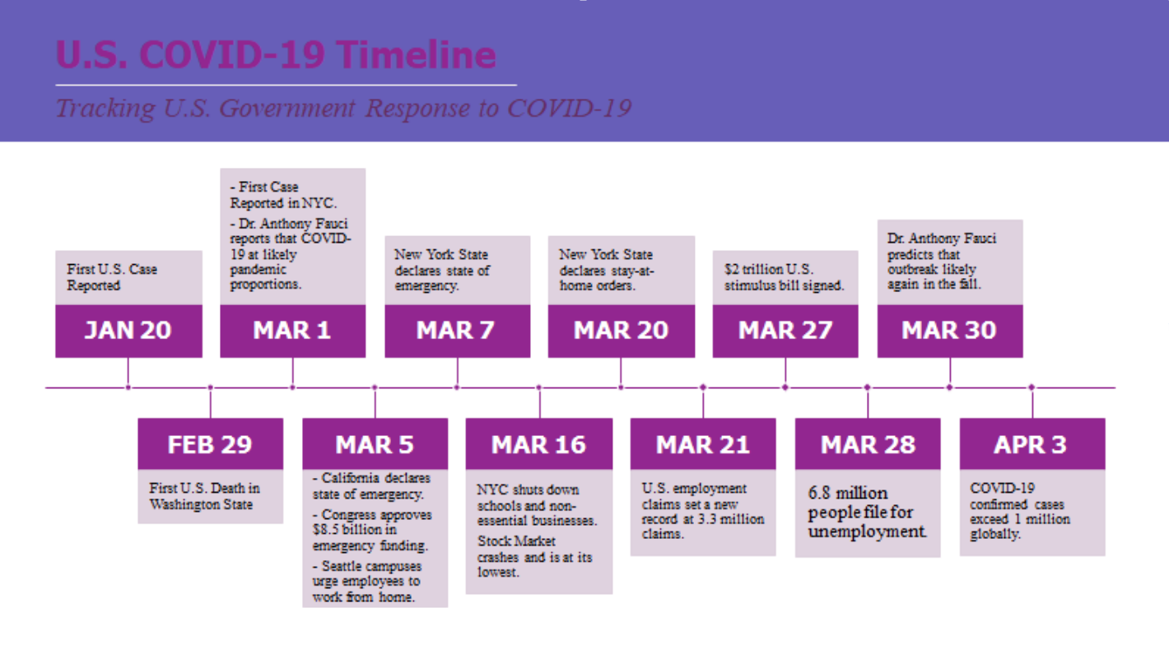
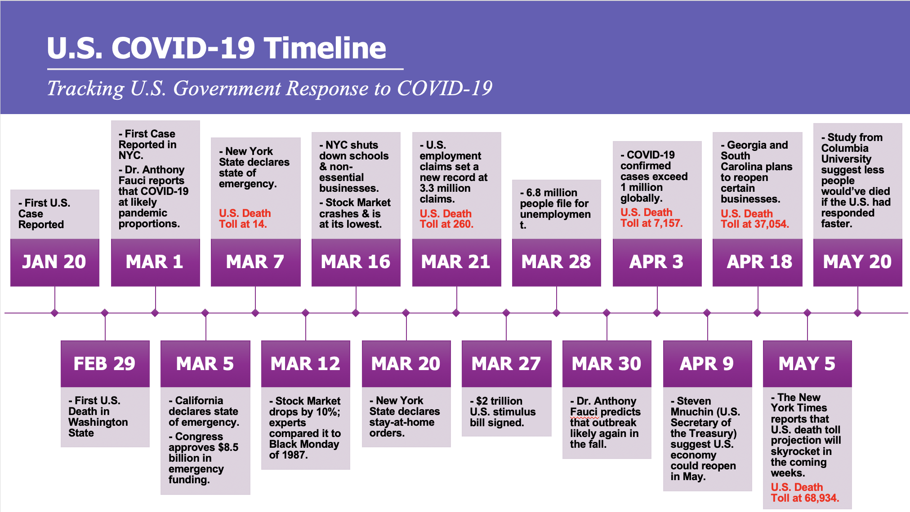
Notes:
Emily-
In our research and analysis of the COVID-19 pandemic, we compiled a timeline of important dates to keep in mind and we believe that the U.S. government was slow to respond to the severity of the situation and did not take the virus seriously.
First U.S. case reported as early as January, a man who had traveled to China and returned home to Washington State.
The 1st U.S. death occurred in Washington State, a patient in his 50s with underlying conditions died at the Evergreen Health Hospital.
Health officials are theorizing that COVID-19 has already been spreading in Washington State for at least 6 weeks now before the first death. Some post-mortem studies has also shown that two deaths from early February in the SF Bay Area were potential COVID-19 cases.
On March 1st, the 1st case was reported in NYC and also on the same day – Dr. Anthony Fauci (insert his title) project that at this point, we are likely moving out from an outbreak and into a pandemic situation.
March 5th – Congress passes emergency spending package that is meant for COVID-19 prevention, preparation, and response efforts, as well as extending funding for public health programs to provide telemedicine.

Slide 5
SURVEY FINDINGS
Notes:
Add chart with total # of people by age
Shak-
From 117 sample size, we get
77% people have their bachelor’s degree
70% are female who did the survey
23% applied for an unemployment insurance
32% qualified for an insurance
43% ranges 18-24 age
22% people are working in marketing industry

Slide 6
SURVEY FINDINGS

Slide 7
SURVEY FINDINGS
TOP 10 INDUSTRY BY EMPLOYMENT

Slide 8
SURVEY COMMENTS
Small business owners are suffering the most
Independent contractors don’t have clients
Most individuals received reduction in their salaries
Some companies freeze on employees’ promotion
People concern about finding a job after their graduation
Most people work remotely
Individuals worry about finding a job due to less job-listings

Slide 9
UNEMPLOYMENT RATE
MOST AFFECTED
The highest rates are seen in industries that require direct contact and cannot rely on remote work to provide services.
Consumer confidence and severe retail-traffic decline are a huge factor.

Slide 10
UNEMPLOYMENT RATE
Jobs that require more training and education tend to be in roles where work can be done remotely

Slide 11
UNEMPLOYMENT RATE
WOMEN ARE MOST AFFECTED
"overrepresented in the hardest hit industries , such as leisure and hospitality and education" -The Washington Post

Slide 12
JOB POSTINGS
Notes:
Ranin
Lousiana had the least job postings,
“In the United States, emerging hot spots outside New York include Louisiana, where cases jumped 43 percent in a day, bringing the total to more than 9,000.” - https://www.nytimes.com/2020/04/02/business/economy/coronavirus-unemployment-claims.html

Slide 13
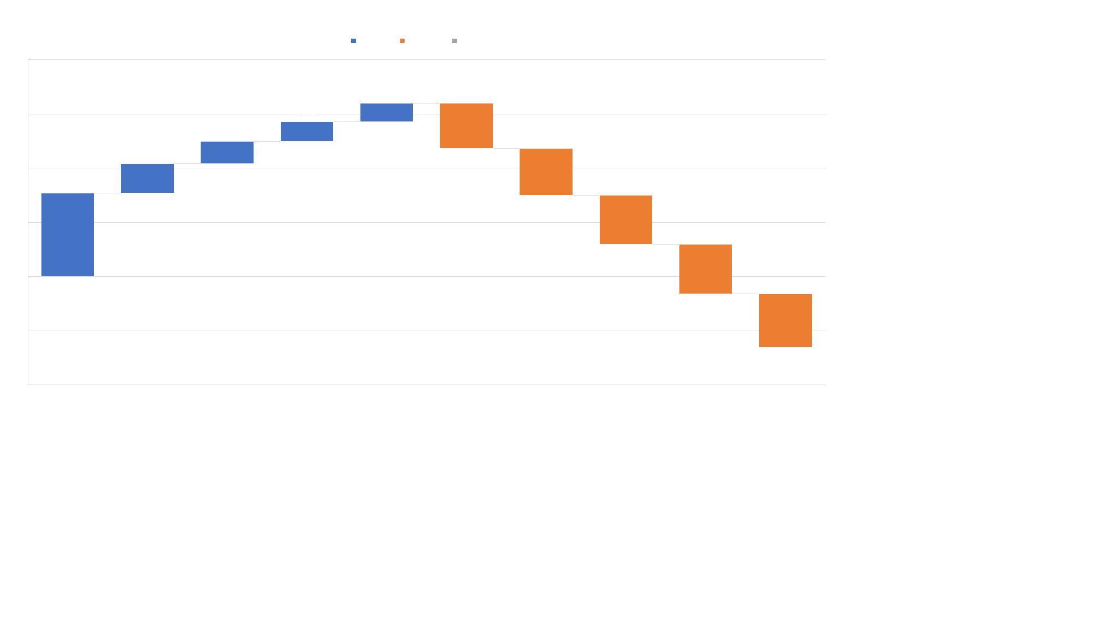
JOB POSTINGS INDUSTRIES
Notes:
https://candor.co/hiring-freezes/?utm_source=morning_brew
ranin

Slide 14
COVID-19 IMPACT ON OCCUPATION IN MARCH
Notes:
Ranin https://www.economicmodeling.com/job-posting-dashboard/
Translators are in demand because hospitals has a lot of non english speaking patients
Stock-moving people are those who work with companies like amazon delvering goods
Photographers are up their because of the pandemic 24/7 news coverage that requires people to be out in the field.
Lastly are the emergency responders who got an increase in demand because of the pandemic
---
The occupations hit the hardest during this pandemic are travel based because the virus moves, so no traveling and no tours. With the lock down people don’t really need oil and gas
As schools close down and be remote there's no demand for teachers nor tutors
Its risky for funeral workers to be at work because most death are from the virus

Slide 15
NEGATIVELY IMPACTED OCCUPATIONS
Notes:
https://www.economicmodeling.com/job-posting-dashboard/
Ranin

Slide 16
U.S Unemployment Insurance Claims
*Numbers reflect seasonally adjusted data.
** Source: U.S Department of Labor

Slide 17
CONCLUSION
US Death Toll is nearing the 100,000.
It is unsustainable to keep the US economy closed but we can't put value to a human life.
The most affected jobs are those that require direct contact with the public.
This is an ongoing pandemic and there is uncertainty following the initial shock.

Slide 18
RECOMMENDATIONS
Companies should evaluate if remote work is feasible for their business and train employees.
Educate the public on UI claims.
Department of labor recruiting.
Less jobs available, rising competition
Department of labor should revamp their site and consider an emergency strategy for situations like this

Slide 19

SOURCES
https://www.bls.gov/news.release/empsit.nr0.htm
https://www.forbes.com/sites/jackkelly/2020/03/19/the-coronavirus-effect-here-are-the-jobs-that-will-be-added-and-lost/#9f263052a1c8
https://www.mckinsey.com/industries/public-sector/our-insights/covid-19-and-jobs-monitoring-the-us-impact-on-people-and-places
https://www.getroman.com/health-guide/timeline-of-events-covid-19-discovery/
https://www.washingtonpost.com/dc-md-va/2020/05/09/women-unemployment-jobless-coronavirus/

